Slide 1
Cyclistic Bike Share Performance
Allison Barton
12/5/2021

Slide 2
Contents
Objective
Examining number of riders
Examining average trip duration
Conclusion
Appendix

Slide 3
Objective:
Identify the differences between annual and casual riders.

Slide 4
Examining number of riders

Slide 5
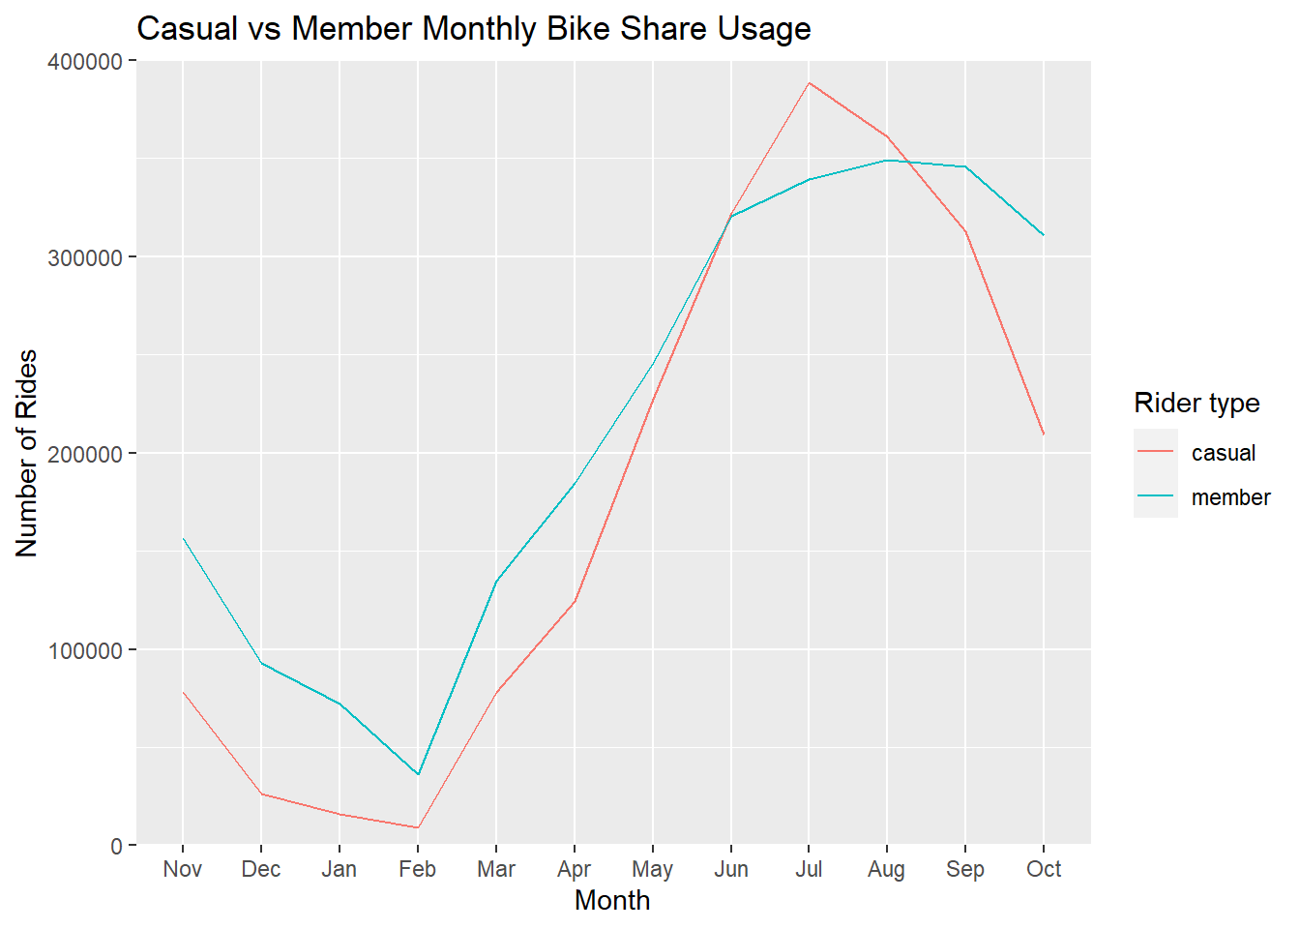
Past Year Membership
Ridership in both populations shows similar trend throughout the year
There tend to be more members than casual riders
Casual riders use Cyclistic more than members during summer months

Slide 6
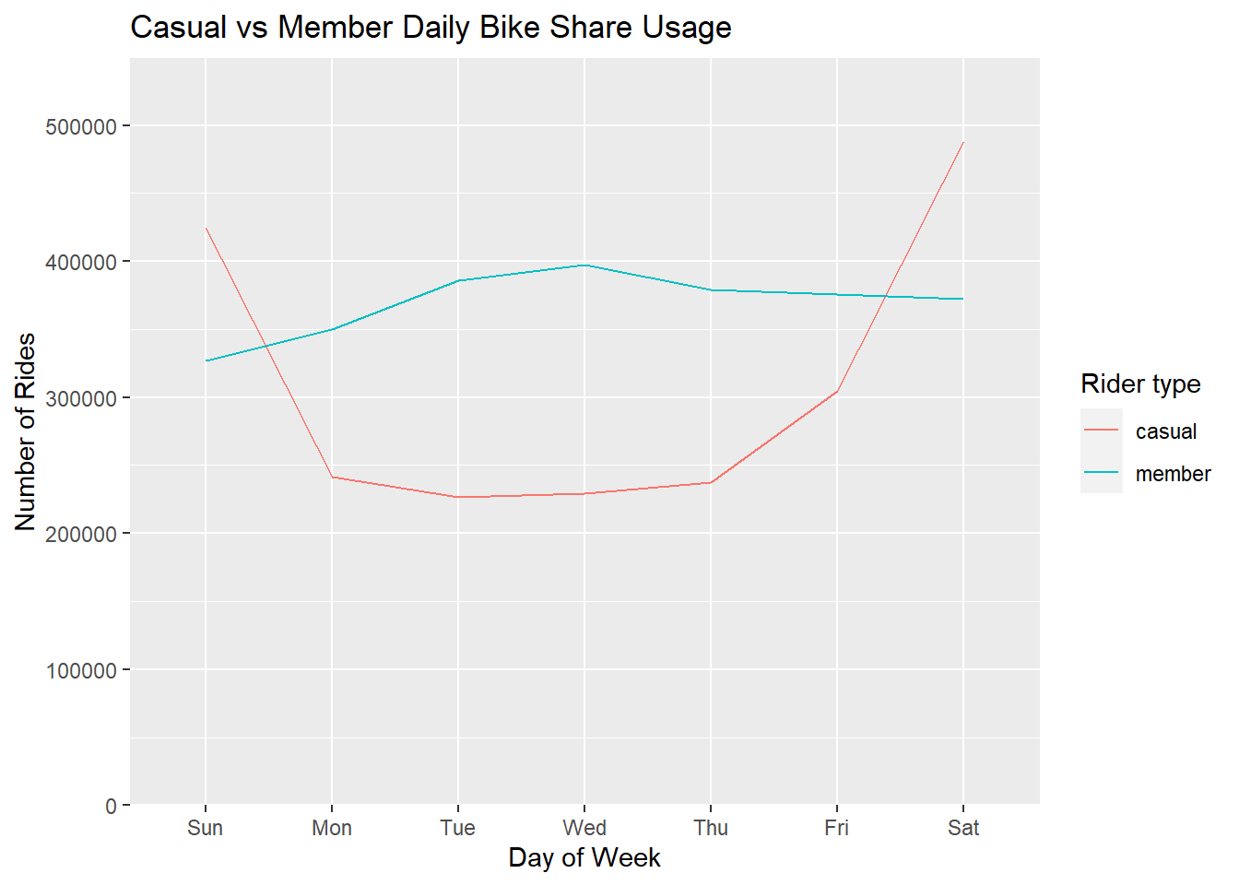
Past Year Weekly Membership
Members tend to use bikes approximately the same throughout the week
Casual riders show significant increase during weekends

Slide 7
Examining average trip duration

Slide 8
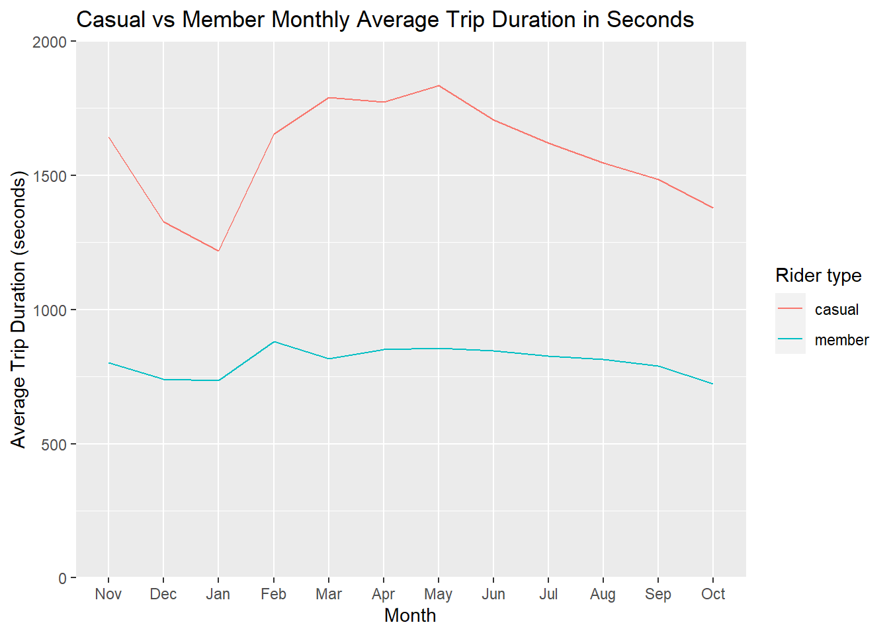
Past Year Average Ride Time
Casual riders keep their bicycles longer per trip
Casual riders show a significant decrease during December and January
The length of members’ trips are approximately the same throughout the year

Slide 9
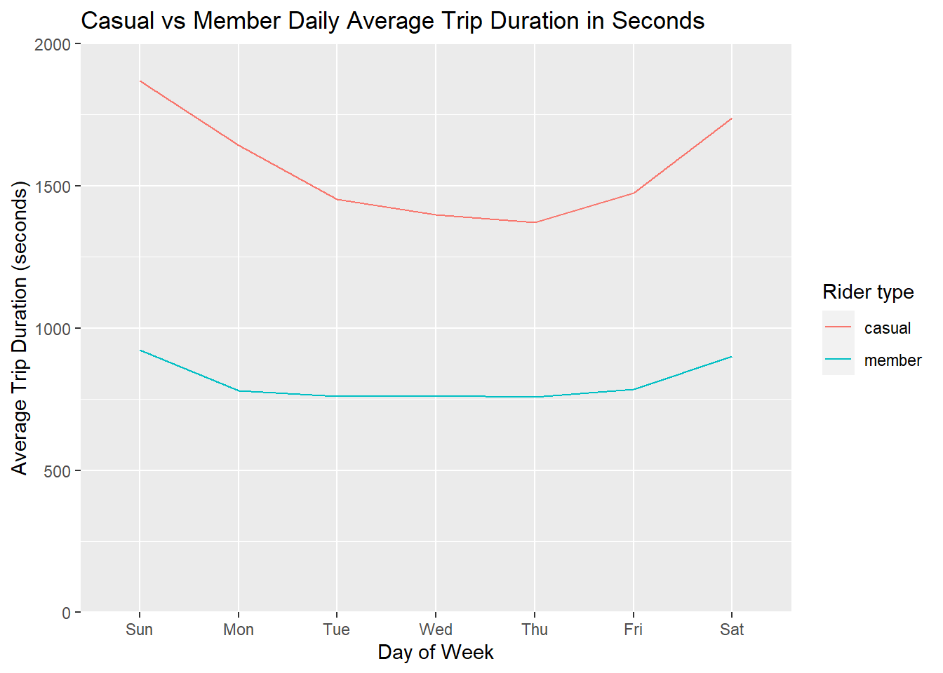
Past Year Weekly Average Ride Time
Casual riders still keep their bicycles longer per trip
Members keep rides approximately the same length throughout the week
Slight increase in average time during the weekend for both types of riders

Slide 10
Conclusion
Casual members use Cyclistic more heavily during weekends and summer months
Members use Cyclistic fairly consistently by week and follow seasonal patterns throughout the year
Advertising during summertime and especially weekends may see an increase in memberships
Notes:
members may be using bicycles to go to work/school while casual riders use them for leisure or exercise

Slide 11
Appendix
The R Notebook report of this presentation can be viewed in HTML and PDF forms.
The public data used in this project was provided by Motivate International Inc.

